Slide 1
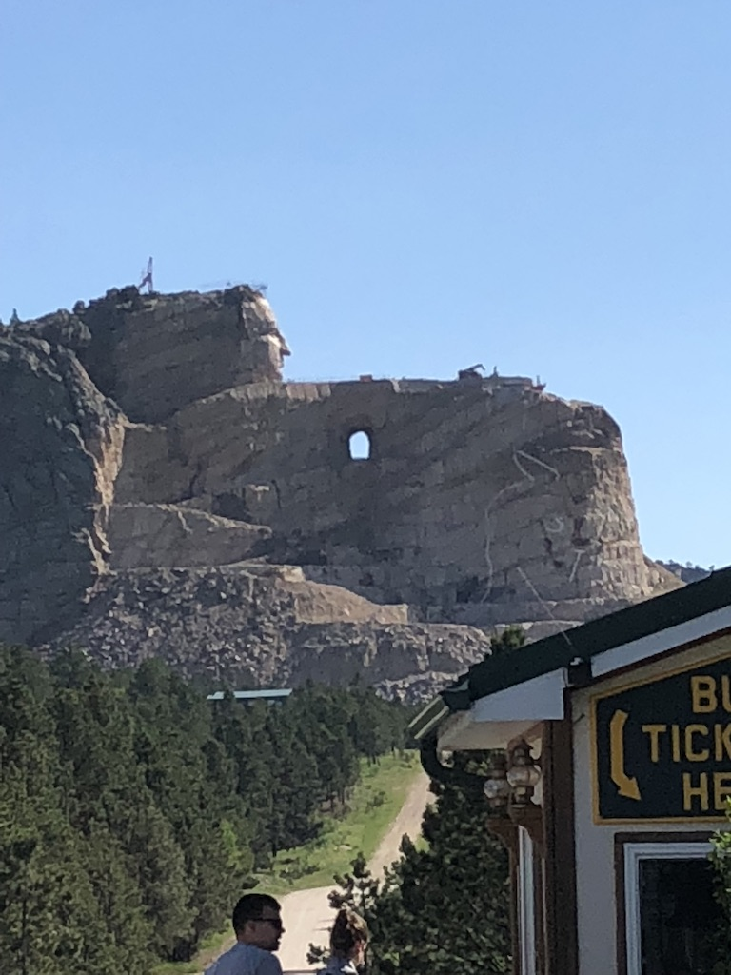
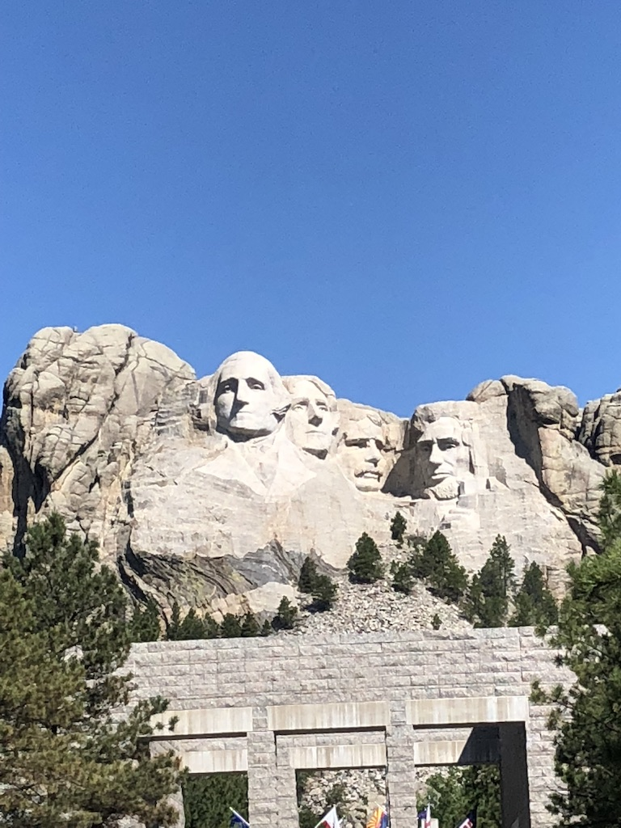
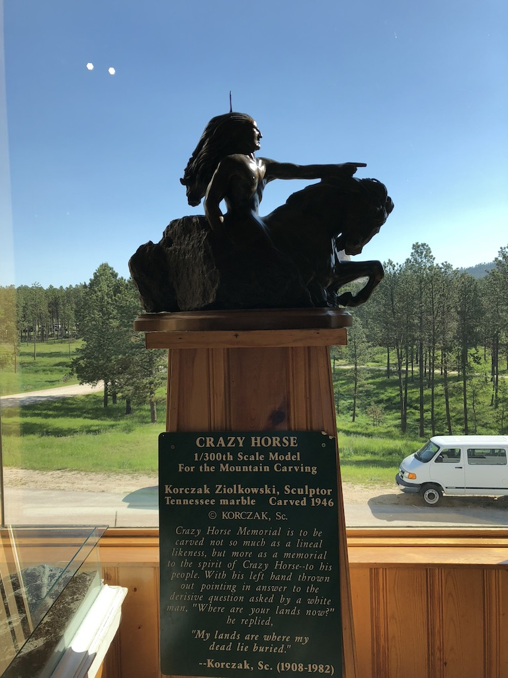
Crazy Horse!
Unit 4 – Probability, Day 2, 3 and 3.5
Your Out-of-Probability-Puns Professor Colton

Slide 2
Unit 4, Day 2 - Outline
Unit 4 - Probability
Contingency Tables and Types of Probabilities
Addition (Or) Rule
Mutually Exclusive Events
Conditional (Given) Probabilities
General Multiplication Rule
Multiplication Rule for Independent Events
“At Least One” Type Probabilities
Summary of Probability Formulas and Important Ideas

Slide 3
Review + New
We saw this kind of setup for probabilities, probability distributions.
Example, rolling a 6-sided fair die one time:
Here, there is really only one thing going on….
Often scenarios aren’t so simple, there is more than one thing of interest.
For example, if the Academic Office has information about student’s major and good attendance standing.
We can study overall how many students have good attendance.
But can we see which majors have the best attendance?
What about for the non attenders, which major do they tend to have?
Or can we only answer “simple“ questions?
Outcome, X: | 1 | 2 | 3 | 4 | 5 | 6 | Total
Probability, P(X): | 1/6 | 1/6 | 1/6 | 1/6 | 1/6 | 1/6 | 1
Total Students: | 435
Major | Students
Statistics | 150
Art | 105
Chemistry | 180
Attendance | Students
Perfect | 220
Good | 140
Poor | 75

Slide 4
Contingency Tables and Types of Distributions (and Probabilities)
Continuing with example, we can organize this data into a contingency table.
Then use this to help us find probabilities!
To help with this, there is terminology for the different parts of the table and their associated probabilities!
Marginal Distributions: Refers to just one “event (variable)”.
Use Column and Row Totals to find these.
Joint Distributions: Refer to two (or more) “events (variable)”
Use the numbers in the middle of the table to find these.
Denominator for both of these types of probabilities is the Total Sample size.
Conditional Distributions: We will talk about these later.
 | Statistics | Art | Chemistry | Total
Perfect | 100 | 40 | 80 | 220
Good | 20 | 50 | 70 | 140
Poor | 30 | 15 | 30 | 75
Total | 150 | 105 | 180 | 435
 | Statistics | Art | Chemistry | Total
Perfect | 100 | 40 | 80 | 220
Good | 20 | 50 | 70 | 140
Poor | 30 | 15 | 30 | 75
Total | 150 | 105 | 180 | 435

Slide 5
LCQ 1: Contingency Tables
Answer the following questions using the Contingency Table below:
a) How many students have good attendance?
b) How many students are Art majors?
c) What percent of the students are Art majors?
d) How many students are Statistics majors AND have Perfect attendance?
 | Statistics | Art | Chemistry | Total
Perfect | 100 | 40 | 80 | 220
Good | 20 | 50 | 70 | 140
Poor | 30 | 15 | 30 | 75
Total | 150 | 105 | 180 | 435

Slide 6
LCQ 1: Contingency Tables
a) How many students have good attendance?
Number Good = 140 = 20 + 50 + 70
Marginal distribution, only one variable
Row total or add up all cells in the row
b) How many students are Art majors?
Number Art = 105 = 40 + 50 + 15
Marginal distribution, only one variable
Column total or add up all cells in the column
c) What percent of the students are Art majors?
P(Art) = 105 / 435 = 0.24, 24%
Still only one variable, Marginal probability = column total / total sample size
We convert this from a number (count) to a probability with the division by total total
Can think of probabilities ass number of successes / total
In this example, Art = Success
d) How many students are Statistics majors AND have Perfect attendance?
Number Stats AND Perfect = 100
Joint distribution,
Two variables, looking at middle numbers (the intersection)
Total, everyone = 435
a) | Statistics | Art | Chemistry | Total
Perfect | 100 | 40 | 80 | 220
Good | 20 | 50 | 70 | 140
Poor | 30 | 15 | 30 | 75
Total | 150 | 105 | 180 | 435
Good = 140
b) | Statistics | Art | Chemistry | Total
Perfect | 100 | 40 | 80 | 220
Good | 20 | 50 | 70 | 140
Poor | 30 | 15 | 30 | 75
Total | 150 | 105 | 180 | 435
Total, everyone = 435
Art = 105
c) | Statistics | Art | Chemistry | Total
Perfect | 100 | 40 | 80 | 220
Good | 20 | 50 | 70 | 140
Poor | 30 | 15 | 30 | 75
Total | 150 | 105 | 180 | 435
d) | Statistics | Art | Chemistry | Total
Perfect | 100 | 40 | 80 | 220
Good | 20 | 50 | 70 | 140
Poor | 30 | 15 | 30 | 75
Total | 150 | 105 | 180 | 435
Total, everyone = 435
Stats
Perfect
100

Slide 7
LCQ 2: Contingency Tables
Answer the following questions using the Contingency Table below:
a) What is the probability a student has Poor attendance AND is a Chemistry major?
b) What is the probability a student is NOT an Art major who has perfect attendance? NOT (Art AND Perfect)
c) How many students are Statistics majors or have Good attendance?
d) How many students have Perfect OR Good attendance?
 | Statistics | Art | Chemistry | Total
Perfect | 100 | 40 | 80 | 220
Good | 20 | 50 | 70 | 140
Poor | 30 | 15 | 30 | 75
Total | 150 | 105 | 180 | 435

Slide 8
LCQ 2: Contingency Tables
Total, everyone = 435
Poor
Chem
a) | Statistics | Art | Chemistry | Total
Perfect | 100 | 40 | 80 | 220
Good | 20 | 50 | 70 | 140
Poor | 30 | 15 | 30 | 75
Total | 150 | 105 | 180 | 435
a) What is the probability a student has Poor attendance AND is a Chemistry major?
P(Poor and Chemistry) = 30 / 435 = 0.068
Another joint probability, need to meet both criteria, Poor and Chem
b) What is the probability a student is NOT an Art major who has perfect attendance? NOT (Art AND Perfect)
We want everyone that is NOT (Perfect and Art) → Start with everyone, 435 and take away the 40 (or add everyone except the 40)
P(NOT (Art and Perfect)) = (435 – 40) / 435 = 0.91
OR solve using Complement rule:
P(NOT (Art and Perfect)) = 1 – P(Art and Perfect) = 1 – 40/435 = 91%
With algebra, this is the same thing as solving the first way
c) How many students are Statistics majors or have Good attendance?
We want Stats OR Good, so lets start by adding up all cells in the Stats column and Good row
Number (Stats OR Good) = Stats + Good= (100 + 20 + 30) + (20 + 50 + 70) = 290
WRONG!! Notice we double counted the 20!! So we need to either intentionally skip them once:
(100 + 20 + 30) + (50 + 70) = 270
OR if we add the Stats column total and the Good Row total, we need to subtract (take away) the 20!
150 + 140 – 20 = 270
Notice that the 20 is the intersection!! That’s why it was double counted at first
30
Total, everyone = 435
b) | Statistics | Art | Chemistry | Total
Perfect | 100 | 40 | 80 | 220
Good | 20 | 50 | 70 | 140
Poor | 30 | 15 | 30 | 75
Total | 150 | 105 | 180 | 435
40
Total, everyone = 435
c) | Statistics | Art | Chemistry | Total
Perfect | 100 | 40 | 80 | 220
Good | 20 | 50 | 70 | 140
Poor | 30 | 15 | 30 | 75
Total | 150 | 105 | 180 | 435
Stats
Good
20

Slide 9
LCQ 2: Contingency Tables
Total, everyone = 435
d) How many students have Chem OR Poor attendance?
Same strategy as part e!
Number Chem OR Poor = (80 + 70 + 30) + (15 + 30) = 225 → Probability = 225 / 435 = 52%
= 180 + 75 - 30 = 225
Don’t double count the 30
e) How many students have Perfect OR Good attendance?
Number Perfect OR Good = 220 + 140 = 360
We don’t have to subtract anything because there is no intersection / overlap (so no double counting)!
d) | Statistics | Art | Chemistry | Total
Perfect | 100 | 40 | 80 | 220
Good | 20 | 50 | 70 | 140
Poor | 30 | 15 | 30 | 75
Total | 150 | 105 | 180 | 435
Poor
Chem
30
Total, everyone = 435
e) | Statistics | Art | Chemistry | Total
Perfect | 100 | 40 | 80 | 220
Good | 20 | 50 | 70 | 140
Poor | 30 | 15 | 30 | 75
Total | 150 | 105 | 180 | 435
Good
Perfect
220
140

Slide 10
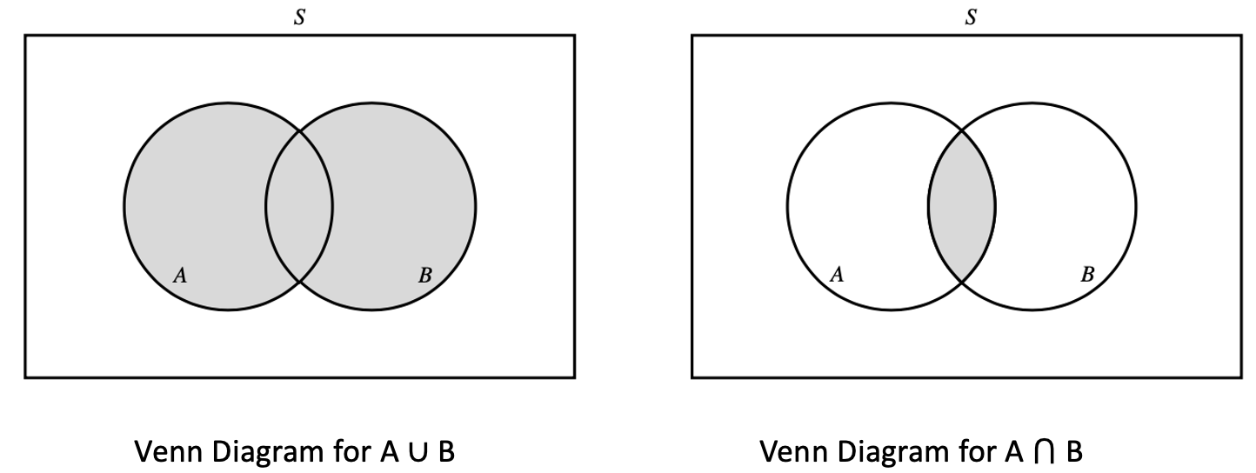
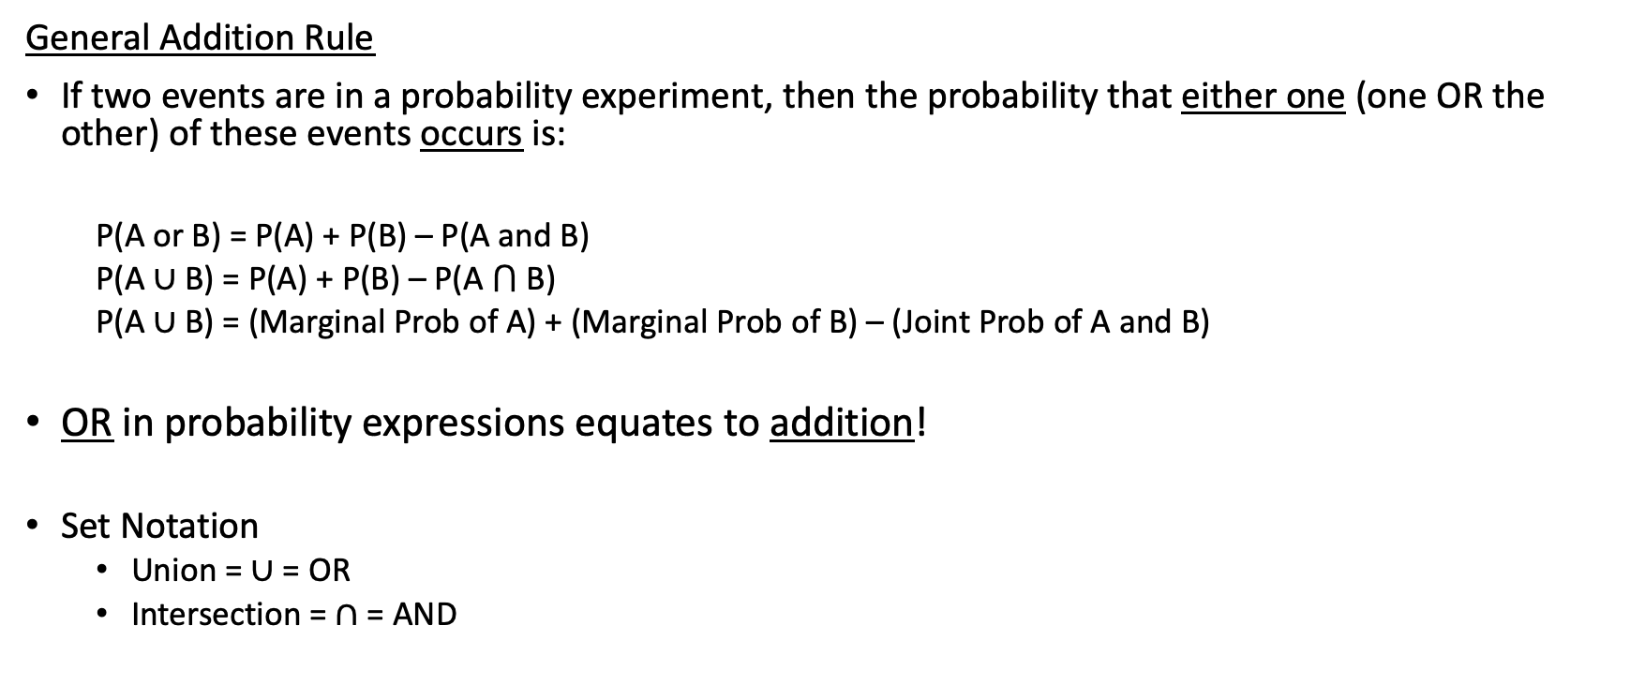
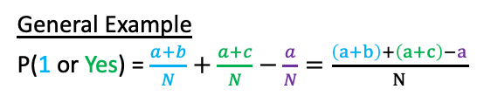
General Addition Rule
Realization
This is what we were doing in the last LCQ (c and d) with the OR problems
Now this is just formalizing it and thinking in terms of probabilities rather than counts like we did previously
General Addition Rule
If two events are in a probability experiment, then the probability that either one (one OR the other) of these events occurs is:
P(A or B) = P(A) + P(B) – P(A and B)
P(A ∪ B) = P(A) + P(B) – P(A ⋂ B)
P(A ∪ B) = (Marginal Prob of A) + (Marginal Prob of B) – (Joint Prob of A and B)
OR in probability expressions equates to addition!
Set Notation
Union = $∪$ = OR
Intersection = $∩$ = AND
 | Yes | No | Total
1 | a | b | a+b
2 | c | d | c+d
Total | a+c | b+d | N
General Example
P(1 or Yes) = $\frac{a+b}{N}+\frac{a+c}{N}−\frac{a}{N}=\frac{\left(a+b\right)+\left(a+c\right)−a}{N}$

Slide 11
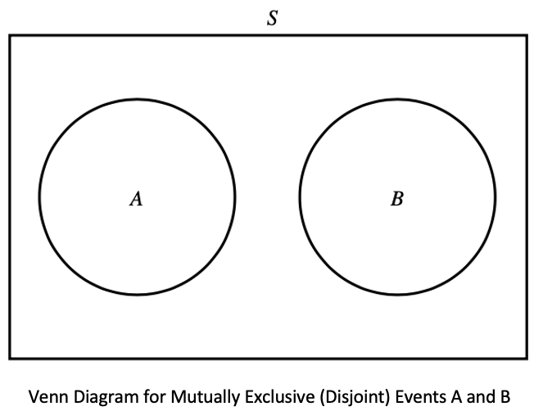
Mutually Exclusive Events
Realization
This was part (e) of the previous LCQ!
Mutually Exclusive (Disjoint)
Two events are mutually exclusive (disjoint) if they CAN NOT occur at the SAME time.
There is NO overlap.
If event A happens, then event B can NOT occur.
In other words, the joint probability of mutually exclusive events equals zero!
P(A and B) = 0
Addition Rule for Disjoint Events
P(A or B) = P(A) + P(B) – P(A and B), well P(A and B) = 0 if disjoint
==> P(A or B) = P(A) + P(B)
We can just add the marginal probabilities!
Example
Drawing one card from a standard 52-card deck.
Selecting a heart and a diamond is NOT possible! Disjoint!
Selecting a 5 and a heart is possible! NOT disjoint!

Slide 12
LCQ: Addition Rule
Answer the following questions using the Contingency Table below:
a) What is the probability a student is an Art major or a Chemistry major?
b) What is the probability a student has Poor attendance OR (Union) is a Chemistry major?
c) What is the probability a student is a Chemistry major AND (Intersection) has Perfect attendance?
d) Are having a Chemistry major and Perfect attendance mutually exclusive? Explain why or why not.
e) Which other events are mutually exclusive?
 | Statistics | Art | Chemistry | Total
Perfect | 100 | 40 | 0 | 140
Good | 0 | 50 | 70 | 120
Poor | 30 | 15 | 30 | 75
Total | 130 | 105 | 100 | 335

Slide 13
LCQ: Addition Rule
a) | Statistics | Art | Chemistry | Total
Perfect | 100 | 40 | 0 | 140
Good | 0 | 50 | 70 | 120
Poor | 30 | 15 | 30 | 75
Total | 130 | 105 | 100 | 335
a) What is the probability a student is an Art major or a Chemistry major?
Using probabilities now instead of just the counts:
P(Art OR Chem) = P(Art) + P(Chem) = 105 / 335 + 100 / 335 = 0.61
With an ‘OR’ problem, start by adding the two marginal probabilities
But there is NO overlap, so we are done (don’t have to subtract anything)
b) What is the probability a student has Poor attendance OR (Union) is a Chemistry major?
Using the formula:
P(Poor OR Chem) = P(Poor) + P(Chem) - P(Poor AND Chem) = (75 / 335) + (100 / 335) – (30 / 335) = 0.43
rearranging with algebra, this is what we did earlier = (75 + 100 - 30) / 335 = 0.43
c) What is the probability a student is a Chemistry major AND (Intersection) has Perfect attendance?
P(Chem and Perfect) = 0 / 335 = 0
For ‘AND’ problems like this, just have to look at the count for the joint and divide by the total sample size!
d) Are having a Chemistry major and Perfect attendance mutually exclusive? Explain why or why not.
YES!!! They are mutually exclusive, because there is no overlap (the joint probability is ZERO)
e) Which other events are mutually exclusive?
Good and statistics, every pair of columns or pair of rows is also mutually exclusive (e.g. Statistics and Art, Good and Poor attendance)
a) | Statistics | Art | Chemistry | Total
Perfect | 100 | 40 | 0 | 140
Good | 0 | 50 | 70 | 120
Poor | 30 | 15 | 30 | 75
Total | 130 | 105 | 100 | 335
a) | Statistics | Art | Chemistry | Total
Perfect | 100 | 40 | 0 | 140
Good | 0 | 50 | 70 | 120
Poor | 30 | 15 | 30 | 75
Total | 130 | 105 | 100 | 335

Slide 14
LCQ: Slightly Different Questions
Answer the following questions using the Contingency Table below:
a) Within students who are Chemistry majors, how many have Good attendance?
b) Of students with Perfect attendance, how many are Statistics majors?
c) If we meet a Statistics student, what is the probability they have Poor attendance?
d) Given that you have Poor attendance, what is the probability you are an Art major?
 | Statistics | Art | Chemistry | Total
Perfect | 100 | 40 | 80 | 220
Good | 20 | 50 | 70 | 140
Poor | 30 | 15 | 30 | 75
Total | 150 | 105 | 180 | 435

Slide 15
LCQ: Slightly Different Questions
Total, everyone = 435
Chem = 180
Good = 70
a) | Statistics | Art | Chemistry | Total
Perfect | 100 | 40 | 80 | 220
Good | 20 | 50 | 70 | 140
Poor | 30 | 15 | 30 | 75
Total | 150 | 105 | 180 | 435
a) Within students who are Chemistry majors, how many have Good attendance?
180 Chemistry, within that 70 Good
We are not looking at everyone now, narrow our search for Good attenders to only the Chemistry column
b) Of students with Perfect attendance, how many are Statistics majors?
220 Perfect, within that 100 Statistics
Now we are focusing on the Perfect row, and within that Statistics
Think of Perfect as additional information that we know from the start
c) If we meet a Statistics student, what is the probability they have Poor attendance?
Finding a probability now. But before we do any calculations, we already know that it’s a Statistics student
So we can just look at the 150 Stats, this will be the new denominator
We are restricting (narrowing) our sample space
Then the success is Poor attendance among the Statistics → 30 Poor attenders out of 150 Stats
P(Poor if know Stats) = 30 / 150 = 20%
d) Given that you have Poor attendance, what is the probability you are an Art major?
Here is another way to phrase this additional info: Given ___, what is probability of ___?
We know it's a Poor attendance (given Info), then within looking for Art → Given 75 Poor Attenders , 15 of which are art majors
P(Art given Poor) = 15/75 = 0.2
Total, everyone = 435
Perfect = 220
b) | Statistics | Art | Chemistry | Total
Perfect | 100 | 40 | 80 | 220
Good | 20 | 50 | 70 | 140
Poor | 30 | 15 | 30 | 75
Total | 150 | 105 | 180 | 435
Stats = 100
Total, everyone = 435
c) | Statistics | Art | Chemistry | Total
Perfect | 100 | 40 | 80 | 220
Good | 20 | 50 | 70 | 140
Poor | 30 | 15 | 30 | 75
Total | 150 | 105 | 180 | 435
Stats = 150
Poor = 30
Total, everyone = 435
d) | Statistics | Art | Chemistry | Total
Perfect | 100 | 40 | 80 | 220
Good | 20 | 50 | 70 | 140
Poor | 30 | 15 | 30 | 75
Total | 150 | 105 | 180 | 435
Poor = 75
Art = 15

Slide 16
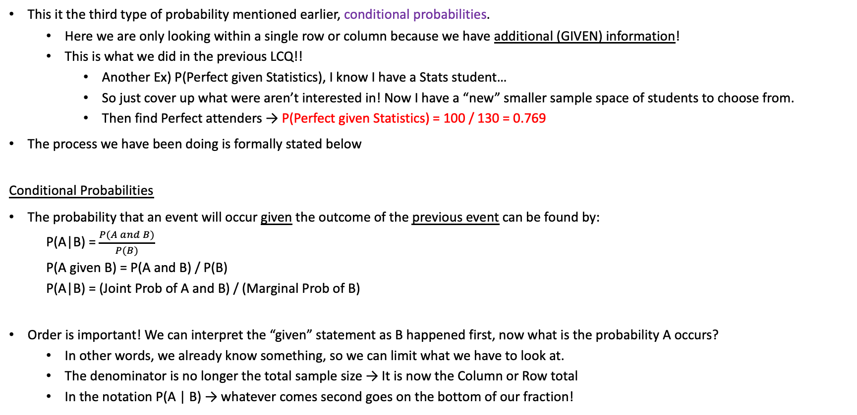
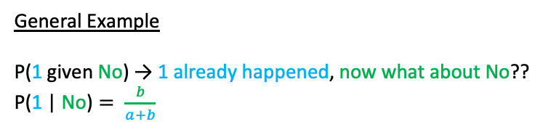
Conditional (Given) Probabilities
 | Statistics | Art | Chemistry | Total
Perfect | 100 | 40 | 0 | 140
Good | 0 | 50 | 70 | 120
Poor | 30 | 15 | 30 | 75
Total | 130 | 105 | 100 | 335
This it the third type of probability mentioned earlier, conditional probabilities.
Here we are only looking within a single row or column because we have additional (GIVEN) information!
This is what we did in the previous LCQ!!
Another Ex) P(Perfect given Statistics), I know I have a Stats student…
So just cover up what were aren’t interested in! Now I have a “new” smaller sample space of students to choose from.
Then find Perfect attenders → P(Perfect given Statistics) = 100 / 130 = 0.769
The process we have been doing is formally stated below
Conditional Probabilities
The probability that an event will occur given the outcome of the previous event can be found by:
P(A|B) = $\frac{P(A and B)}{P(B)}$
P(A given B) = P(A and B) / P(B)
P(A|B) = (Joint Prob of A and B) / (Marginal Prob of B)
Order is important! We can interpret the “given” statement as B happened first, now what is the probability A occurs?
In other words, we already know something, so we can limit what we have to look at.
The denominator is no longer the total sample size → It is now the Column or Row total
In the notation P(A | B) → whatever comes second goes on the bottom of our fraction!
 | Yes | No | Total
1 | a | b | a+b
2 | c | d | c+d
Total | a+c | b+d | N
NOTE
These formulas look slightly different than how we have solved the previous problems….Let’s explain why on the next LCQ!
General Example
P(1 given No) → 1 already happened, now what about No??
$\text{P}\text{(1 | }\text{No}\text{)}= \frac{b}{a+b}$

Slide 17
LCQ: Conditional Probability
1) Answer the following questions using the Contingency Table below:
a) Given a student has Perfect attendance, what is the probability they are a Chemistry major?
b) What is the probability a student has Perfect attendance given they are a Chemistry major?
2) Answer the following questions using the just the information to the right (Gender and Letter Grade):
a) Find P(A|Female)
b) Find P(Male|C)
 | Statistics | Art | Chemistry | Total
Perfect | 100 | 40 | 80 | 220
Good | 20 | 50 | 70 | 140
Poor | 30 | 15 | 30 | 75
Total | 150 | 105 | 180 | 435
P(Male) = | 0.60
P(Female) = | 0.40
P(A) = | 0.50
P(B) = | 0.40
P(C) = | 0.10
P(Male & C) = | 0.025
P(Female & A) = | 0.20

Slide 18
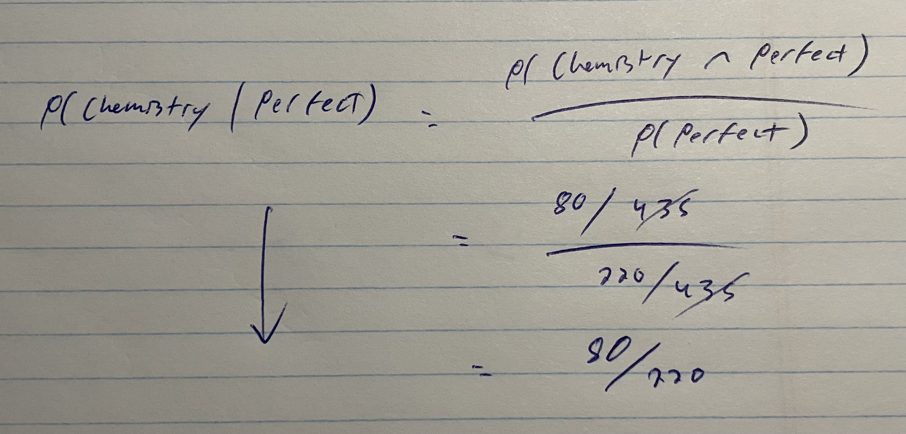
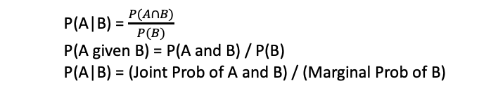
LCQ: Conditional Probability
a) | Statistics | Art | Chemistry | Total
Perfect | 100 | 40 | 80 | 220
Good | 20 | 50 | 70 | 140
Poor | 30 | 15 | 30 | 75
Total | 150 | 105 | 180 | 435
P(A|B) = $\frac{P(A∩B)}{P(B)}$
P(A given B) = P(A and B) / P(B)
P(A|B) = (Joint Prob of A and B) / (Marginal Prob of B)
1) Answer the following questions using the Contingency Table below:
a) Given a student has Perfect attendance, what is the probability they are a Chemistry major?
Here’s what we have done:
220 Perfect attenders, within 80 Chemistry majors
P(Chemistry given Perfect) = 80 / 220 = 0.36
P(Chemistry | Perfect)
b) What is the probability a student has Perfect attendance given they are a Chemistry major?
This is the reverse of part a) Notice the difference!
P(Perfect | Chemistry) = 80 / 180 = 0.44
Order in P( __ | __ ) is important, here Chemistry is the additional, given info and we want Perfect!
So the denominator is different, but the numerator is the same!
2) Answer the following questions using the just the information to the right (Gender and Letter Grade):
Find P(A|Female)
Now we have to use the formula because we don’t have a contingency table
P(A | Female) = P(A AND Female) / P(Female) = 0.2 / 0.4 = 0.5
b) Find P(Male|C)
P(Male AND C) / P(C) = 0.025 / 0.10 = 0.25 → It’s a common mistake to accidentally do the reverse!!!!!
P(C | Male) = P(Male and C) / P(Male) = 0.025 / 0.6 = 0.041 → Numerator is the same again, but denominator is different because of what is given now
Here’s using the formula exactly:
We find the joint probability on the top
And the marginal prob on the bottom
Result: We see that the total sample size 435 cancels from both the top and bottom, which leaves us with 80 / 220
SAME things as before!
Key idea: By only looking at the Perfect row, and looking at Chem only in there, we essentially skip the beginning probabilities
This is the advantage of using a Contingency table to solve these problems!
b) | Statistics | Art | Chemistry | Total
Perfect | 100 | 40 | 80 | 220
Good | 20 | 50 | 70 | 140
Poor | 30 | 15 | 30 | 75
Total | 150 | 105 | 180 | 435
P(Male) = | 0.60
P(Female) = | 0.40
P(A) = | 0.50
P(B) = | 0.40
P(C) = | 0.10
P(Male & C) = | 0.025
P(Female & A) = | 0.20

Slide 19
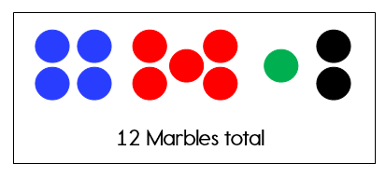
More Complicated Events
Previous probability rules dealt with only one “stage”, selecting one item.
We can find probabilities for more complex scenarios or multiple stages.
Classic example:
If I have a jar of colored marbles and want to select two of them.
Lets say I replace the first one after choosing it:
What is the probability both are blue?
What is the probability I select a red and then a green?
Probabilities stay the SAME because after the first selection they are replaced
We could also NOT replace it and ask the same questions:
Now what is the probability both are blue?
Now what is the probability I select a red and then a green?
If I select a black marble first, what is the probability the second marble is green?
Probabilities CHANGE because after the first selection they are NOT replaced (new total remaining and maybe number of colors of interest)
https://www.algebra-class.com/probability-problems.html

Slide 20
Thirsty?
A cooler contains nineteen Mountain Dews and seven Dr. Peppers. If we choose two drinks at random from the cooler, what is the probability that we get one of each type of soda?

Slide 21
Solving the Thirsty? Problem
A cooler contains nineteen Mountain Dews and seven Dr. Peppers. If we choose two drinks at random from the cooler, what is the probability that we get one of each type of soda?
P(Mountain Dew) = 19/26
P(Dr. Pepper) = 7/26
Sample Space: {MD MD, MD DP, DP MD, DP DP}

Slide 22
Steps in Developing & Using a Tree Diagram
Divide the experiment into stages
Draw a tree diagram.
Each level of branches corresponds to a stage in the experiment.
For each level, there should be a branch for each possible outcome of the particular stage.
Attach probabilities to each branch in the tree.
Beyond the first level, these will often be conditional probabilities.
To determine the probability of a specific branch sequence, multiply the probabilities of all the individual branches in the sequence.
To determine the probability of an event, add up probabilities of all of the complete sequences that make the event true.

Slide 23
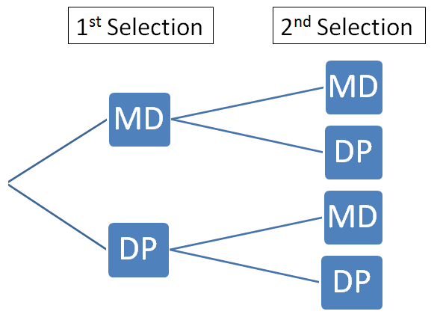
Solving the Thirsty? Problem
Sample Space: {MD MD, MD DP, DP MD, DP DP}
Step 1) Stages
Step 2) Branches

Slide 24
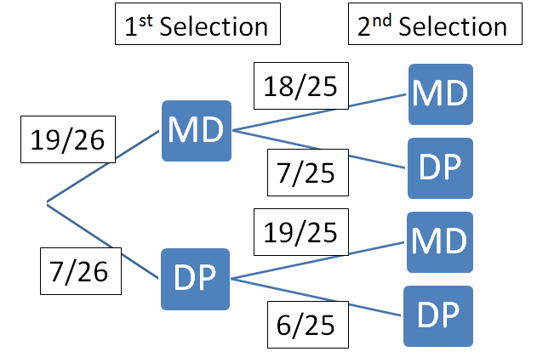
Step 3) Probabilities
Realizations
Probabilities on the second selection are different based on what happened first!!
Conditional probabilities!!!
We have a new total (because one drink has been taken from the cooler and not replaced) and potentially a new numerator in our probability as well
P(Mountain Dew) = 19/26
P(Dr. Pepper) = 7/26
BRANCH PROBABILITIES OFF ONE EVENT MUST SUM TO 1!!

Slide 25
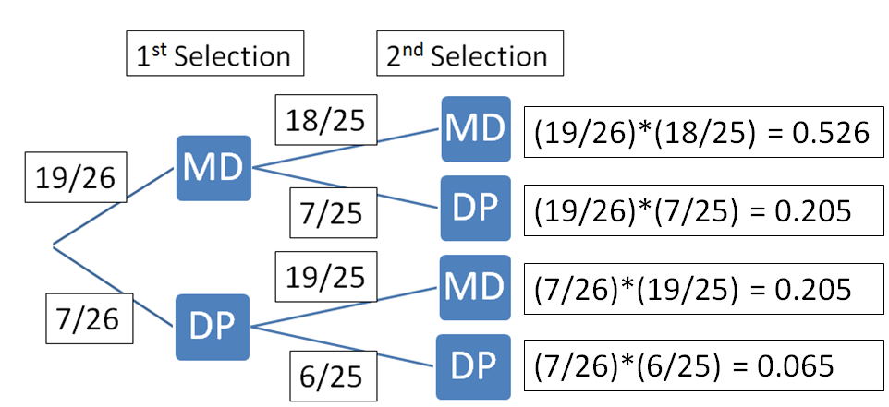
P(one of each type) = Branch 2 + Branch 3
These are the two branches that meet our criteria!
Step 4) Multiply Across
** AND = multiply
MD AND MD
Branch
Sample Space
1
P(MD) x P(MD|MD)
MD, MD
2
P(MD) x P(DP|MD)
MD, DP
3
P(DP) x P(MD|DP)
DP, MD
4
P(DP) x P(DP|DP)
DP, DP
P(one of each type) = P[(MD AND DP) OR (DP AND MD)]
= P(MD, DP) + P(DP, MD)
= 0.205 + 0.205 = 0.410
Step 5) Add final probabilities for branches of interest
** OR = addition

Slide 26
More Examples
Once we have the whole tree set up correctly, we can answer any questions for this scenario!
P(2 DP OR One of each) = Add up branches 2, 3, 4 = 0.205 + 0.205 + 0.065 = 0.474
P(2 DP) = P(DP AND DP) = Only branch 4 = 0.065
Just have to find the branches of interest (the ones that meet our criteria for the outcome(s) we want) and add up the probabilities
Branch
Sample Space
1
P(MD) x P(MD|MD)
MD, MD
2
P(MD) x P(DP|MD)
MD, DP
3
P(DP) x P(MD|DP)
DP, MD
4
P(DP) x P(DP|DP)
DP, DP

Slide 27

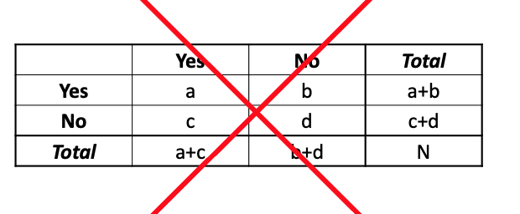
General Multiplication Rule
(General) Multiplication Rule
If two events are in a probability experiment, then the probability that both events (one and then the other) occur is:
P(A and B) = P(A) x P(B|A) --- P(B) x P(A|B)
P(A ⋂ B) = P(A) x P(B|A)
P(A and B) = (Marginal Prob of A) x (Conditional Prob of B Given A)
AND in probability expressions equates to multiplication!
So we are multiplying the probabilities of the two events, BUT…
The scenario (probabilities) changes after the first event, so we have to use the conditional probability for the second event!
So we are taking into account the first event in the second expression.
As we saw, we are going to use Tree Diagrams to solve these kind of problems!
NOT Contingency Tables!
Realization
This is exactly what we just did in the previous example, just formalized
http://propbabilitywebquest.weebly.com/tree-diagrams.html

Slide 28
LCQ: Multiplication Rule
Setup: Lets say I am selecting a power team of two students from our class and am interested in their class standing. I know that for our class of 20 students, we have:
10 freshman (F), 6 sophomores (S) and 4 juniors (J).
What is the probability I select one freshman and one sophomore?
Draw a tree diagram and assign probabilities for the FIRST stage of this probability experiment.
Continue the tree diagram for the second stage of the probability experiment.
Find the final probability of interest.

Slide 29
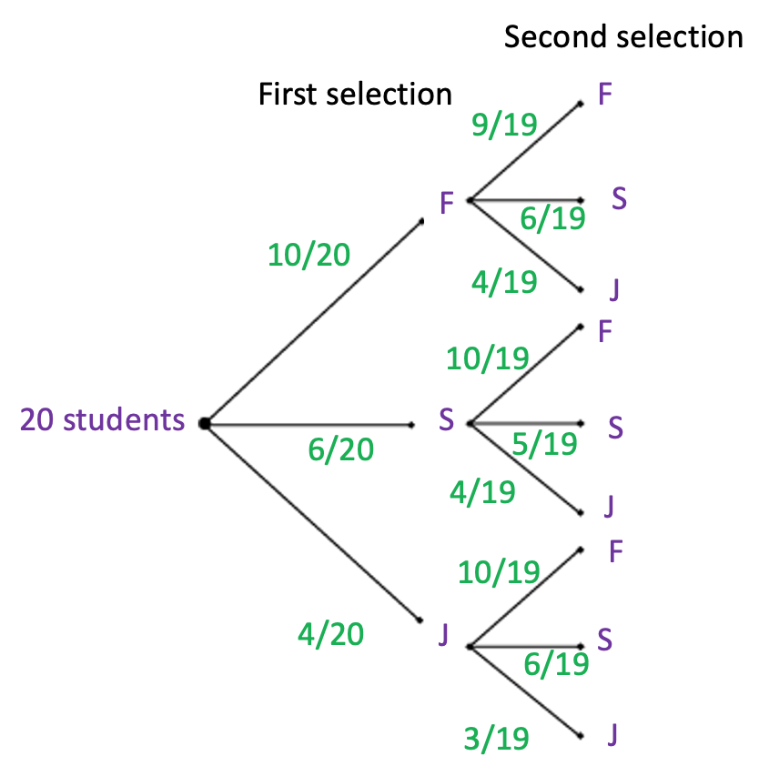
Scenario: 10 freshman (F), 6 sophomores (S) and 4 juniors (J).
What is the probability I select one freshman and one sophomore?
Branch
P(one F and one S) = ??
Which branches do I want?? 2 and 4
Just multiply across tree!!
1
2
Branch 2: P(F and then S) = P(F) x P(S|F)
= 10/20 x 6/19
= 0.158
3
4
Branch 4: P(S and then F) = P(S) x P(F|S)
= 6/20 x 10/19
= 0.158
5
6
P(one F and one S) = P((F and then S) OR (S and then F))
= 0.158 + 0.158
= 0.316
7
8
Could also answer other questions:
P(2 J) = Only branch 9
= P(J) x P(J|J)
= 4/20 x 3/19
= 0.032
9
Need to put J on tree diagram even though we aren’t interested in them!

Slide 30
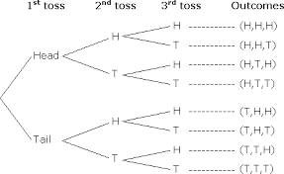



Another Example
Setup: I am flipping a fair coin three times.
What is the probability I flip two heads and one tails?
0.5
0.5
0.5
0.5
0.5
0.5
0.5
Each outcome (branch): 0.5 x 0.5 x 0.5 = 1/8 = 0.125
0.5
P(2 H and 1 T) = 3 x 1/8 = 3/8
Notice!
All the conditional probabilities are the same as the marginal! This is different than the last examples…
There is an easier way to think about these without the tree diagram!

Slide 31
Independent Events
Independent Events
Two events are independent if the prior event has NO effect on the subsequent selection.
For example: Rolling dice, picking cards with replacement, spinning a roulette wheel, and guessing on test questions.
These are all independent since your chances of success don't change for each trial.
It can also be unrelated stages, such as flipping a coin and then rolling a die.
Examples of NOT independent events (i.e. dependent):
Drawing marbles without replacement or selecting children for a recess sports game.
Probabilities of Independent Events
If two events are independent, the first event does NOT change the probability of the second event!
We can write this in terms of conditional probability:
P(A|B) = P(A)
and likewise
P(B) = P(B|A)
The advantage of this is demonstrated in the next LCQ!!

Slide 32
LCQ: Multiplication Rule for Independent Events
Setup: If I have a jar of colored marbles and want to select two of them with replacement.
a) Are these events independent or dependent?
b) What is the probability both are blue?
c) What is the probability I select a red and then a green?

Slide 33
LCQ: Multiplication Rule for Independent Events
Setup: If I have a jar of colored marbles and want to select two of them with replacement.
a) Are these events independent or dependent?
Independent → so now we can solve this much easier than before!
b) What is the probability both are blue?
Because these are independent, the probabilities on the second selection are the EXACT same as the first selection (no conditional probability adjustments are needed)!
P(Success) = P(Blue) = 4/12 → P(Blue and Blue) = P(Blue) x P(Blue) P(Blue | Blue) = 4/12 x 4/12 = 0.11
c) What is the probability I select a red and then a green?
Same logic here! No conditional probabilities, just use the marginal (original) probabilities for both selections
P(Red and Green) = P(Red) x P(Green) P(Green|Red) = 5/12 x 1/12 ≈ 0.035

Slide 34
Multiplication Rule for Independent Events
Multiplication Rule for Independent Events
P(A and B) = P(A) x P(B|A), well P(B|A) = P(B) if A and B are independent
==> P(A and B) = P(A) x P(B)
We can just multiply the marginal probabilities!
Redoing Previous Example
Setup: If flipping a fair coin three times, what is the probability I flip two heads and one tails, P(2H and 1T)?
Well, probabilities for H or T from each coin toss doesn’t depend on the previous toss… So these events are independent!
So we can skip the tree diagram and just think about the sample space and multiply!
S = {HHH, HHT, HTH, THH, TTH, THT, HTT, TTT}
Each H or T has equal probability ==> P(H) = P(T) = 0.5 each toss.
So each simple outcome has a probability of: ½ x ½ x ½ = 1/8
Event of interest is two heads and one tails, this happens three times is the sample space.
So final answer is: 3 x 1/8 = 3/8
Realization
This is exactly what we just did in the previous LCQ, just formalized

Slide 35
“At Least One” Type Probabilities
Sometimes we need to find the probability that an event occurs at least once in several independent trials.
Example) A fair coin is tossed five times. What is the probability that it comes up heads at least once?
The easiest way to calculate these probabilities is by finding the probability of the complement by using The Complement Rule we learned previously.
Recall that A’ (Not A) the complement A → P(Not A) = 1 - P(A).
Solve Example
The complement of “at least one” is “none” → For this context, it is “at least one H” and “no H”
P(at least one H) = 1 – P(no H) < using the complement rule >
= 1 – P(TTTTT) < rewriting the event → no Heads means all Tails >
= 1 – 0.5(0.5)(0.5)(0.5)(0.5) < because each toss is independent, so can directly multiply >
= 1 – 0.5⁵
= 0.969
S = {0,1,2,3,4,5}

Slide 36
Probability Formulas and When they are used
Or probabilities: P(A or B) = P(A) + P(B) - P(A and B)
Disjoint Events: Events A and B are disjoint if P(A and B) = 0 and P(A or B) = P(A) + P(B)
Conditional Probabilities: P(A|B) = P(A and B) / P(B)
Look for “clue” words; of, given, among
Among seniors,...
… , given you scored a basket.
Of graduates,...
Looking at a subset of the population.
Independent Events: If Events A and B are independent, then…
P(A|B) = P(A)
P(B|A) = P(B)
So P(A and B) = P(A) * P(B)
Unless you know the two events are independent, do not use P(A and B) = P(A) x P(B) to find P(A and B)

Slide 37
Disjoint vs. Independent
A and B are Independent means event A does not affect/influence the chances of event B occurring.
Independent Example: The probability of rolling a 6 doesn’t influence the probability of drawing a heart from a deck of cards. Unrelated.
Not Independent Example: The probability of passing a math quiz influences the probability you pass that math class. Related, harder to pass class if a poor result on the quiz.
A and B are disjoint if they can’t occur at the same time and hence have a probability of P(A and B) = 0.
If A and B are disjoint, then they are not independent. (knowing one occurs influences the other, influences it to not occur).
If A and B are not independent, it does not mean they are disjoint!

